Slide 1
Modeling Gene Inheritance
An interactive website,
made with Ruby

Slide 2
Overview
Fascinated by expression via dominant and recessive genes
Interested in which genes might carry over multiple generations
Combine programming knowledge with web design knowledge
Interactive website allows user to:
Run the model with multiple parameters
Easily see results

Slide 3
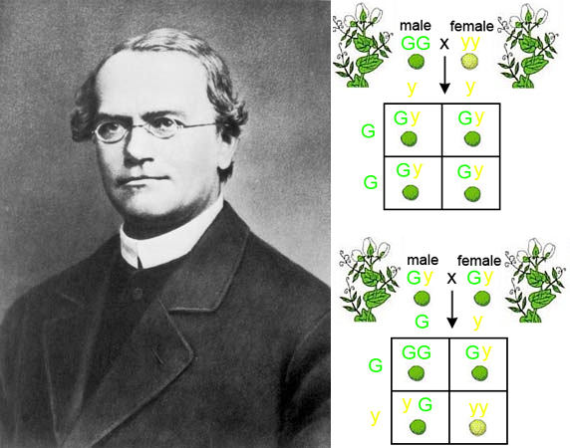
Simple Genetics
Gregor Mendel’s Pea experiments
Some Peas green, others yellow

Slide 4
The end Product
User defines an even number of individuals for 1st generation
Program assigns one gene pair to each person
People swap genes and create a new person
New people pair off and swap genes, creating more people
This goes on until there is one person
See the final gene pairing and examine:
the odds for getting that set of genes
how many genes and what type existed
where they were lost in the family tree

Slide 5
To Do’s - Programming
User input for 1st generation
Will define how many people
Define Struct to hold biographical and genetic information
Program a way for 2 people to swap genes and make a new person
Automate population reproduction
People should pair off and make new people until there is only one

Slide 6
Step 1
Allow user to define an even number of people for first generation
Prompt user for input
Prompt again if number is not even and between 2 – 10
Convert input to an integer and store in a variable

